Slide 1
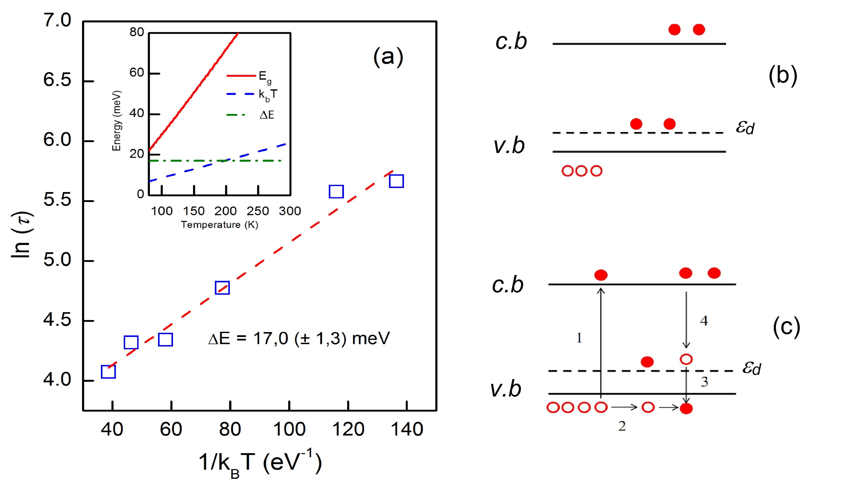
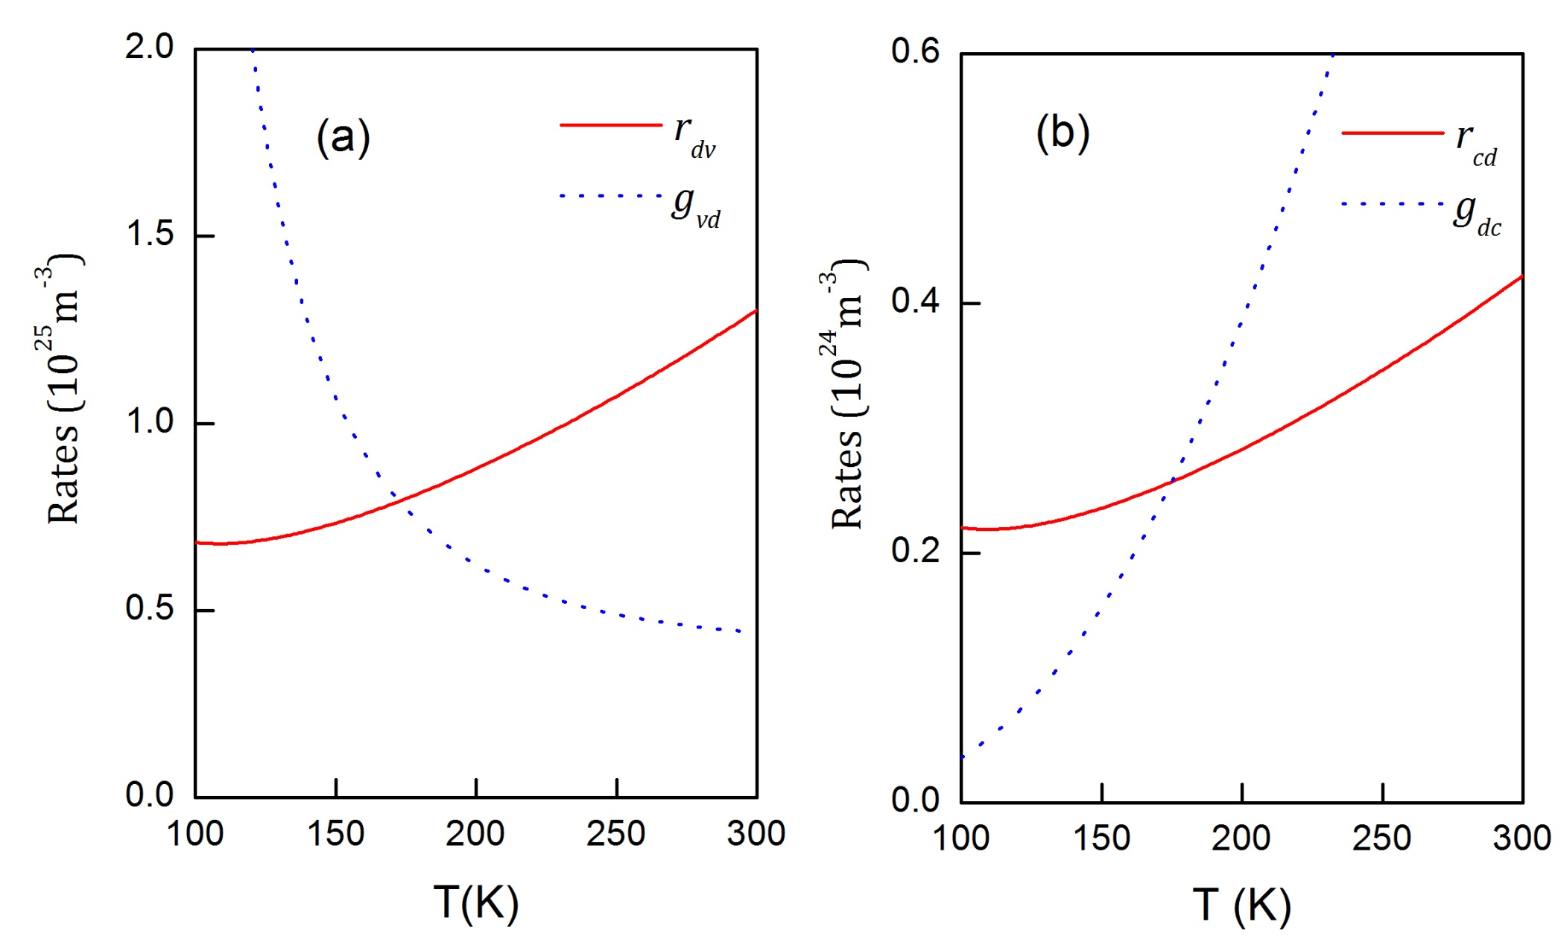
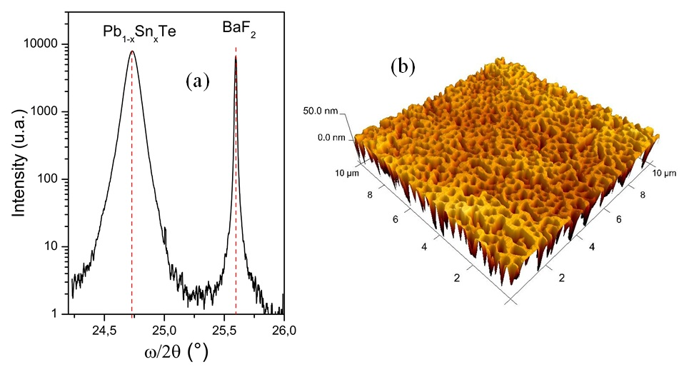
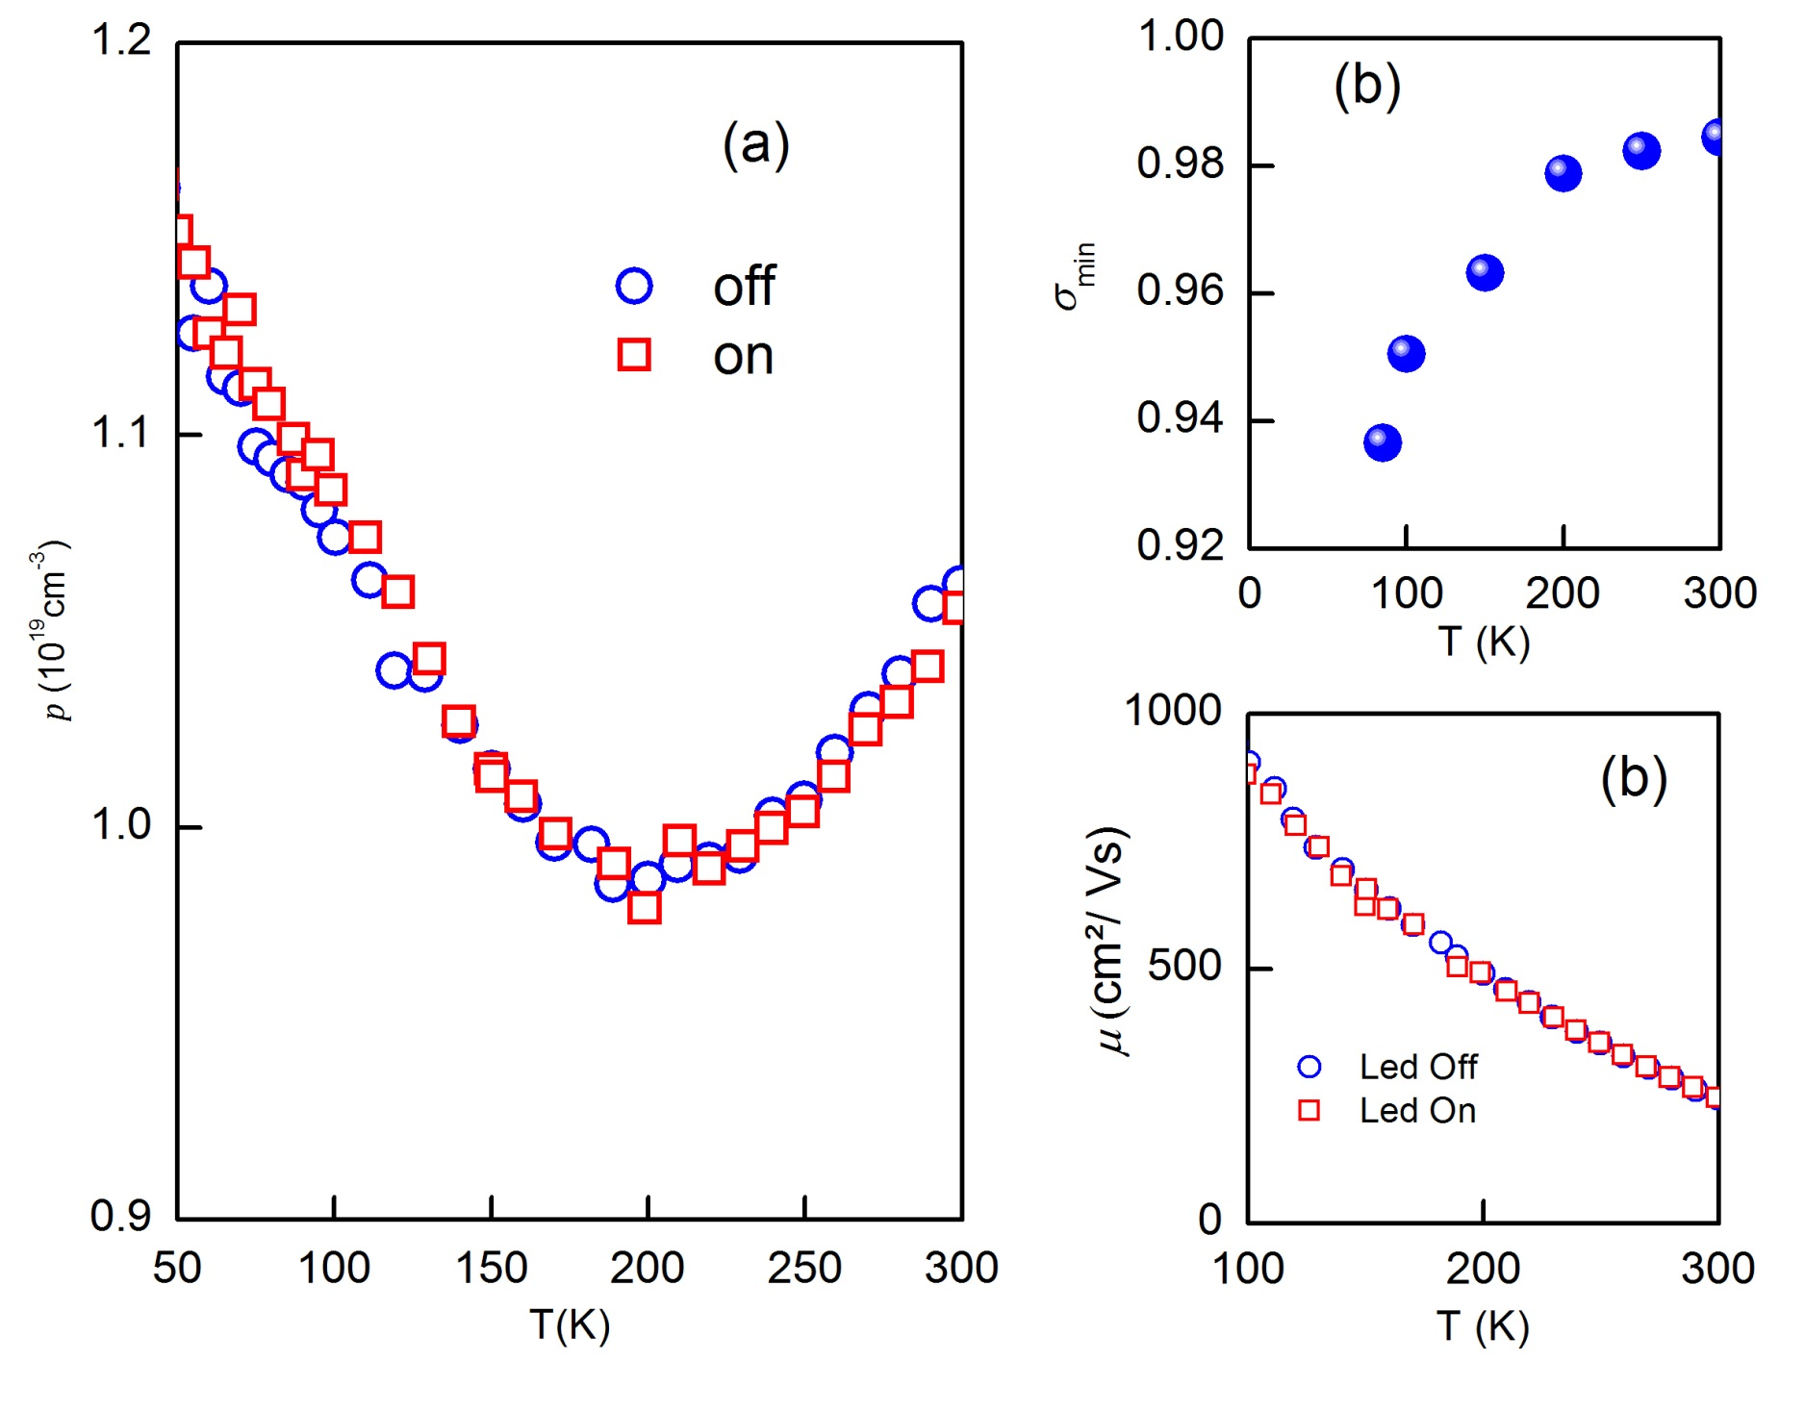
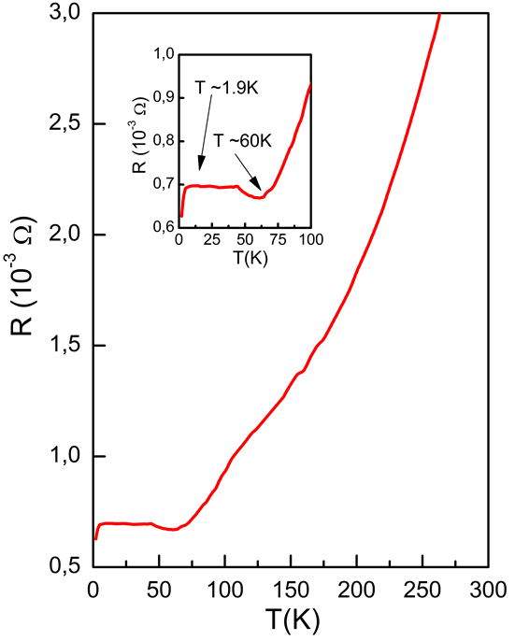
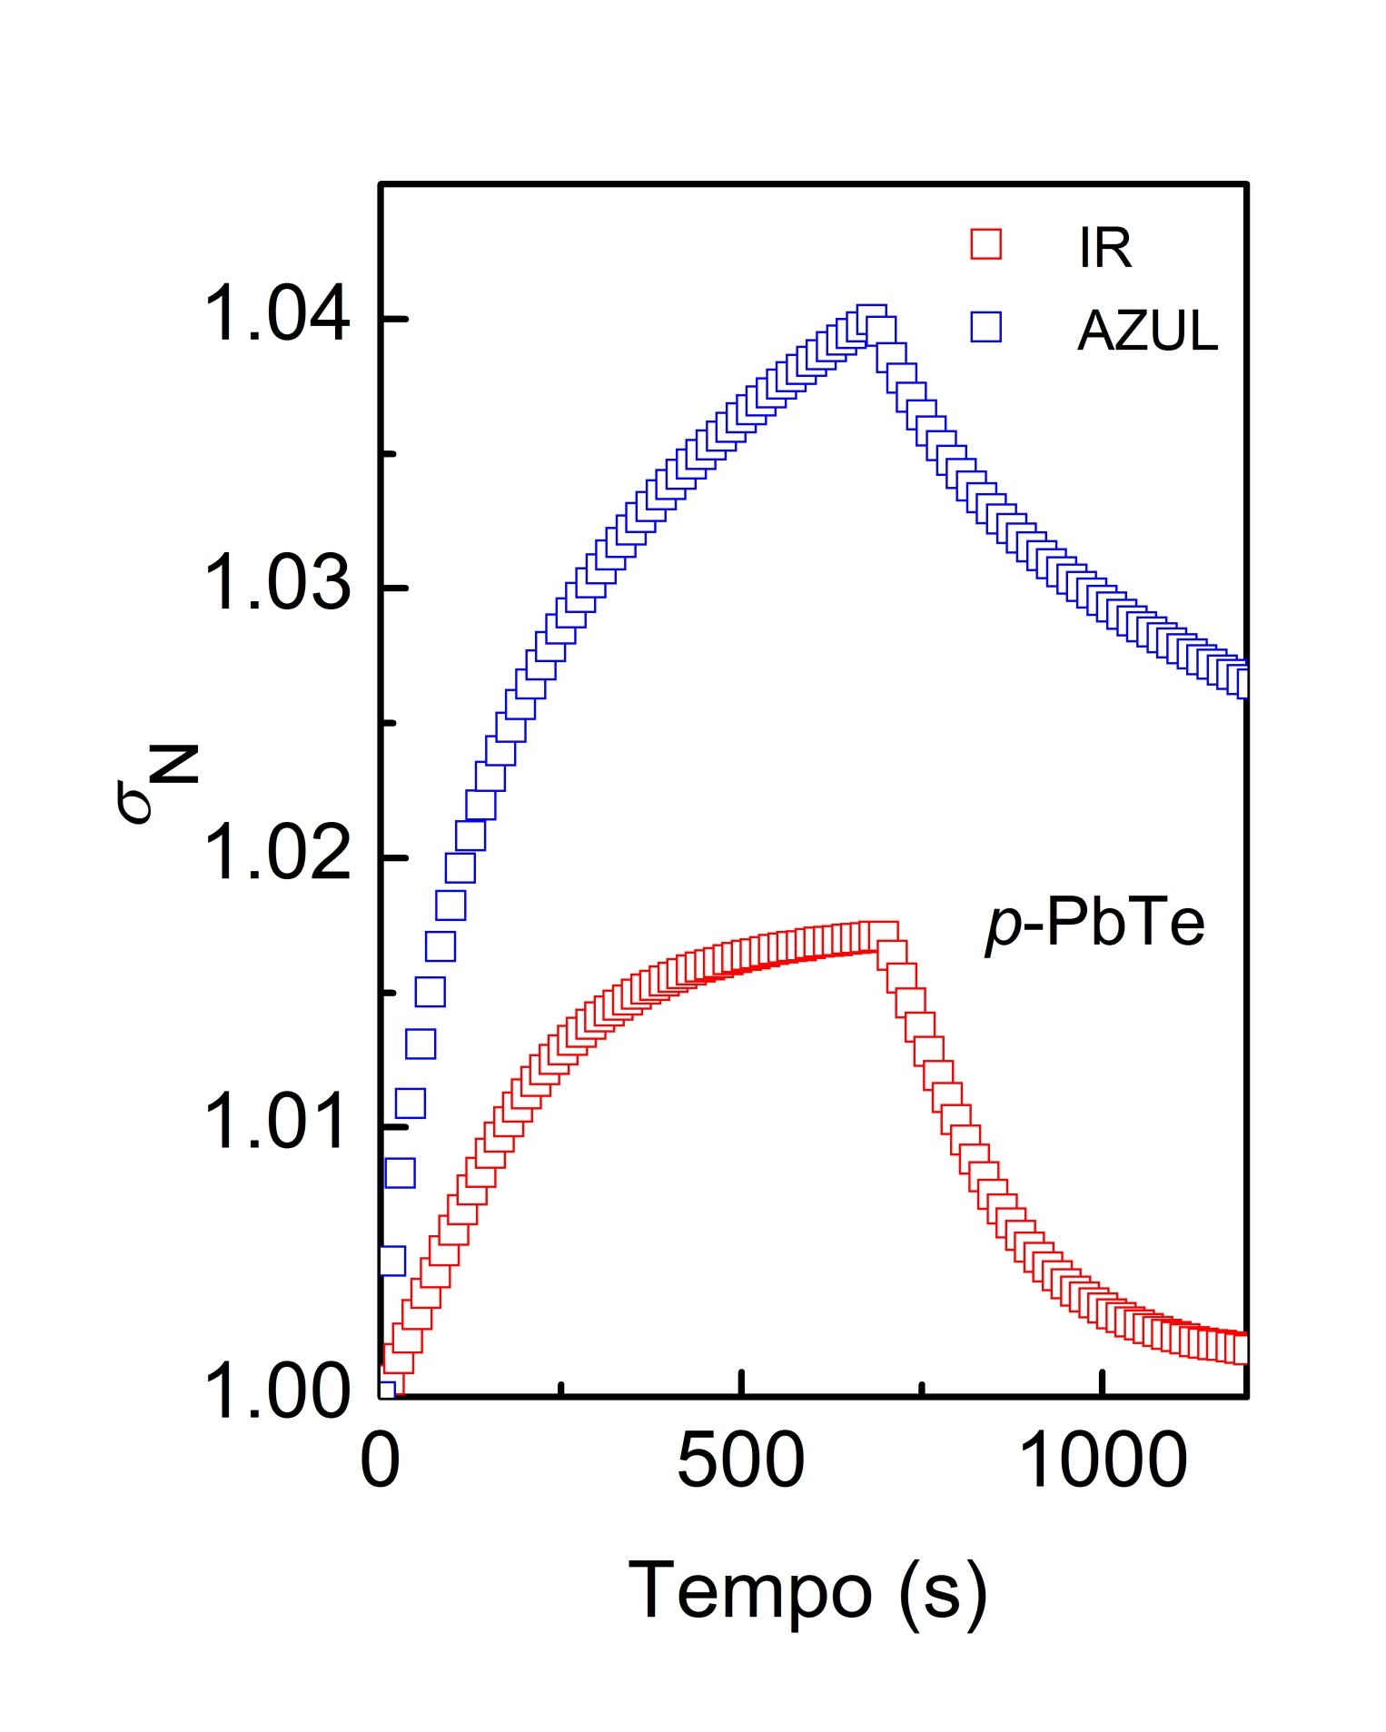
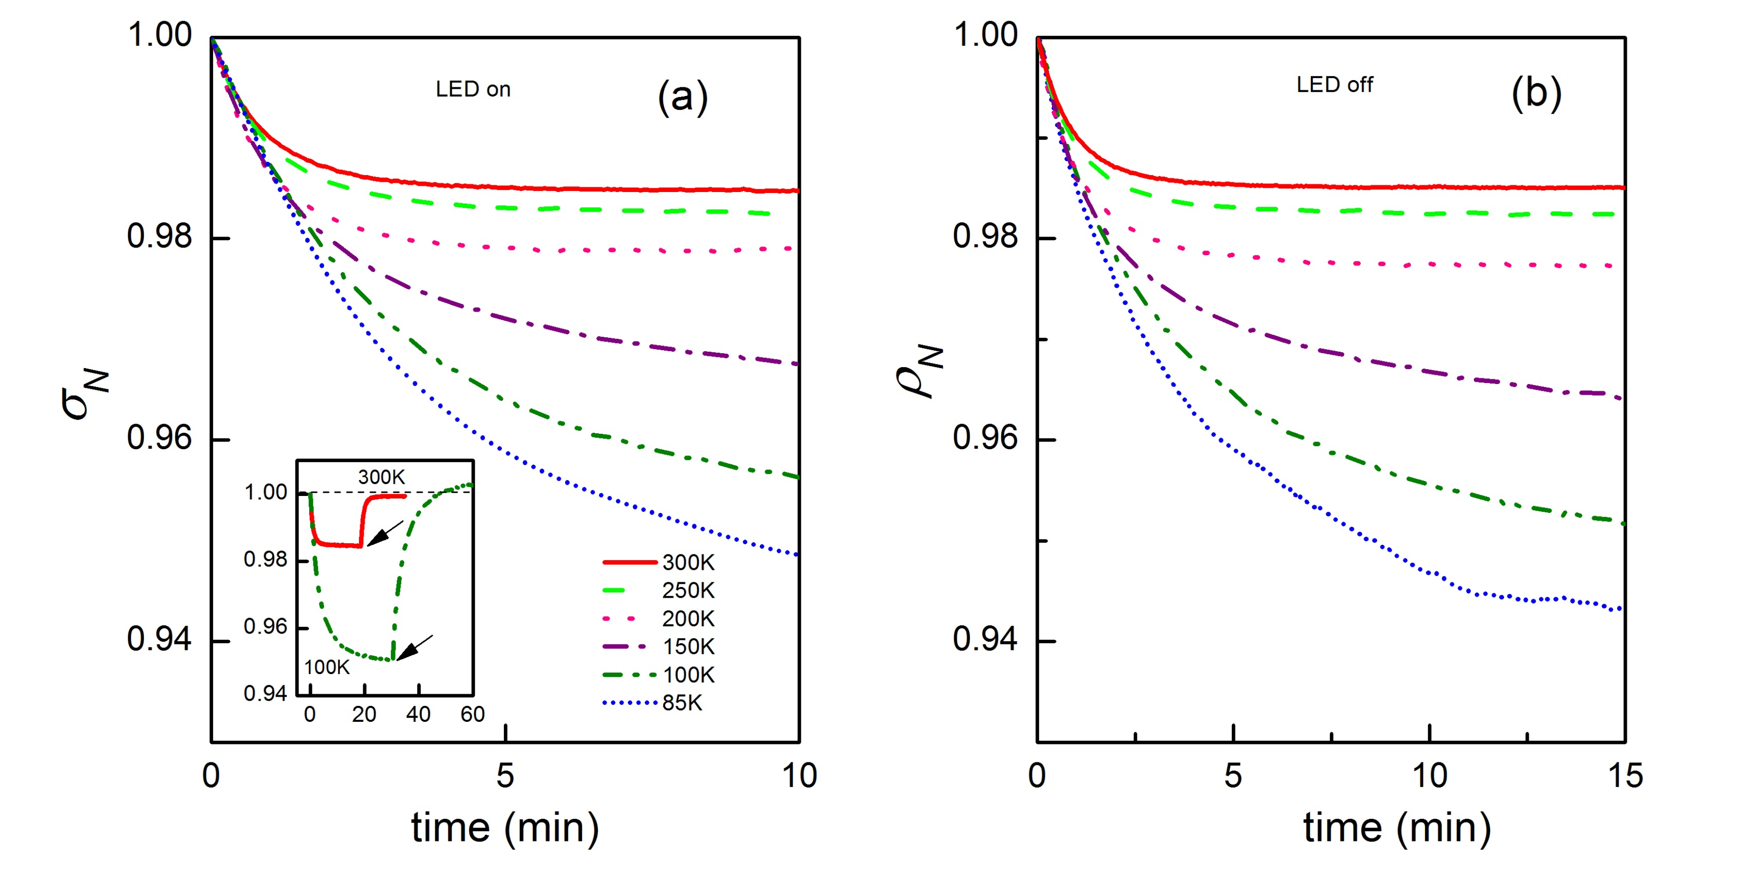
Anomalous photoconductivity in topological crystalline
insulator Pb_{1-x}Sn_{x}Te
M. A. B. Tavares¹, M. L. Peres¹, D. A. W. Soares¹, E. Abramof² , A. K.Okazaki², C. I. Fornari², P. H. O. Rappl²,
¹Instituto de Física e Química, Universidade Federal de Itajubá, Itajubá, MG CEP 37500-903, Brazil
²Laboratório Associado de Sensores e Materiais, Instituto Nacional de Pesquisas Espaciais, São José dos Campos, PB 515, SP CEP 12201-970, Brazil
e-mail: marcelos@unifei.edu.br
I. Introduction
For PbTe based materials, it is well known that trap states are located inside the band gap and are originated from the intrinsic disorder introduced during the sample growth [1] and when illuminated these materials present positive photoconductivity [2]. The introduction of Sn atom changes the position of the trap level in relation to the maximum of the valence band and alters the generation and recombination rates when the sample is illuminated [1].
In this work, we present the results of photoconductivity measurements performed in a p‑type Pb_{1-x}Sn_{x}Te film, grown on (111) cleaved BaF₂ substrate, for x~0.44. We observed the NPC effect at room temperature and also that its amplitude increases as temperature decreases. We show that the NPC effect is a consequence of the reduction of electrons and holes in the conduction and valence bands, respectively, due to the influence of the trap level in the dynamics of the generation and recombination rates when the sample is illuminated.
We investigated the negative photoconductivity (NPC) effect that was observed in a p‑type Pb_{1-x}Sn_{x}Te film for temperatures varying from 300 K down to 85 K. We found that this effect is a consequence of defect states located in the band gap that act as a trapping level changing the relation between the generation and recombination rates. Theoretical calculations predict contributions to the NPC from both conduction and valence bands which is in accordance to the experimental observations.
Figure 4. (a) Plot of $ln(τ$) as a function of $1/k_{B}T$. Inset: Thermal energy k_{B}T, $∆E$ the energy gap $E_{g}$. (b) and (c) schematic representation of the transitions taking in account the trap level ($ε_{d}$).
IV. Analysis
$∆p=∆n+{∆n}_{d}$(1)
$∆σ=e(μ_{n}∆n+μ_{p}∆p)$ (2)
$r_{dv}=pn_{d}vS_{p}$ (3)
$r_{cd}=n(N_{d}−n_{d})vS_{n}$ (4)
$g_{vd}=(N_{d}−n_{d})N_{v}vS_{p}exp(−\frac{E_{g}−ε_{d}}{k_{B}T})$ (5)
$g_{dc}=n_{d}N_{c}vS_{n} exp(−\frac{ε_{d}}{k_{B}T})$(8)
III. Experimental Results
Figure 1. Atomic force microscopy image of (111) Pb_{0,56}Sn_{0.44}Te, 1 μm thick epitaxial film. This image of (10x10) μm² shows that voids still prevail in the sample surface morphology. .
Figure 2. Fotoconductivity curves for an undoped PbTe film under blue and IR light illumination. The amplitude is positive, presenting the expected behavior for semiconductors.
Figure 5. (a) Hole concentration in dark conditions and under illumination. (b) Values for which the NPC amplitude, $σ_{min}$, saturates. (c) Experimental hole mobility measured under light and dark conditions for T=100 – 300 K.
Figure 7. Temperature dependence of the electrical resistivity for a Pb_{0,56}Sn_{0.44}Te film. At lower temperatures, T<4K, the drop indicate a possible superconductor effect.
V. Conclusions
PbSnTe samples present negative photconductivity effect
The NPC effect is caused due to the defect level present inside the band gap
The sample also present the persistent photoconductivity effect also due to the defect level.
References
[1] K. Lischka, R. Durstberger, G. Lindemann, and H. Stauding, Phys. Stat. Sol. (b)123, 319 (1984).
[2] S. de Castro, D. A. W. Soares, M. L. Peres, P. H. O. Rappl, and E. Abramof, Appl. Phys. Lett. 105, 162105 (2014).
V. Acknowledgements
Figure 3. Time dependence of the normalized photoconductivity $\left(σ_{N}=\frac{σ_{light}}{σ_{dark}}\right)$ for Pb_{0.6}Sn_{0.44}Te film in the temperature range of 85 – 300K under illumination. The inset exhibits the buildup and decay at 300K and 100K, under illumination and dark conditions (see the arrows for LED off). (b) The values of $ρ_{N}=1/σ_{N}$ for the temperatures presented in (a) when the illumination is removed revealing the effect of persistent photoconductivity.
The authors acknowledge the Brazilian Agencies CNPq, CAPES and FAPEMIG for financial support.
Notes:
1

